Slide 1

41013 Robotics
Lab Assignment #2
Modelling the uArm and DoBot

Slide 2
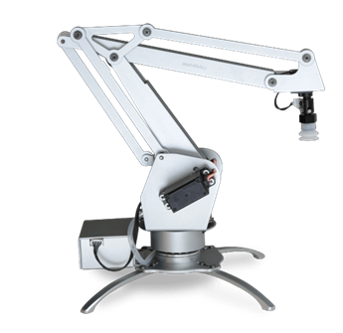
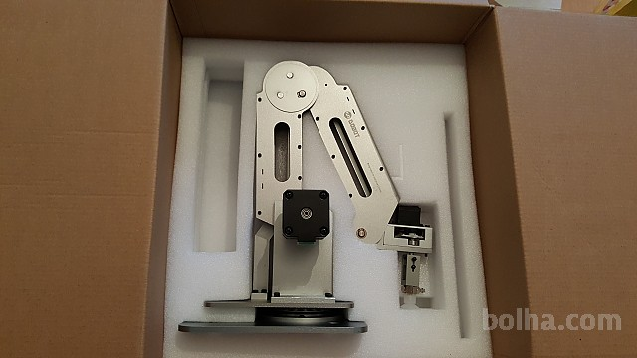
uArm DoBot

Slide 3
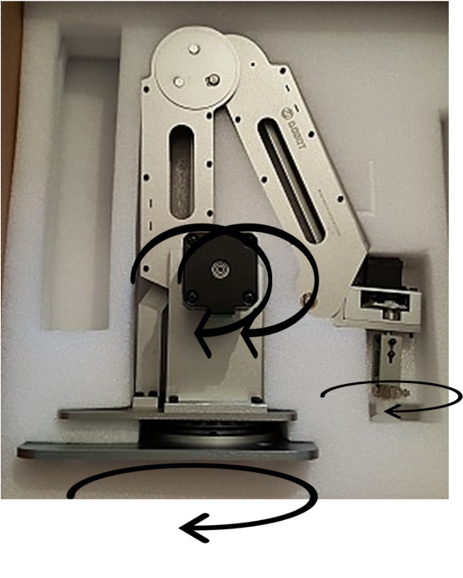
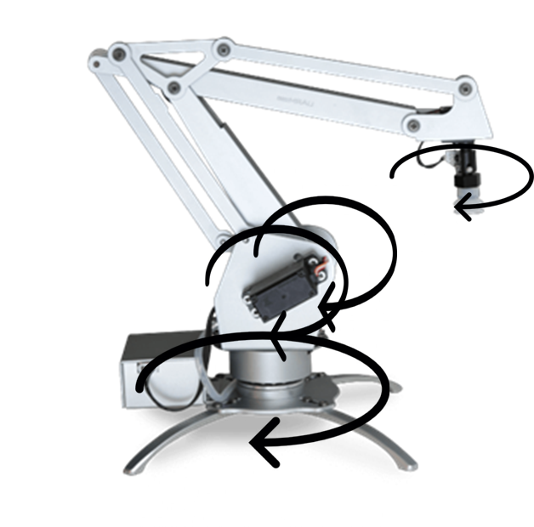
Motor Locations

Slide 4
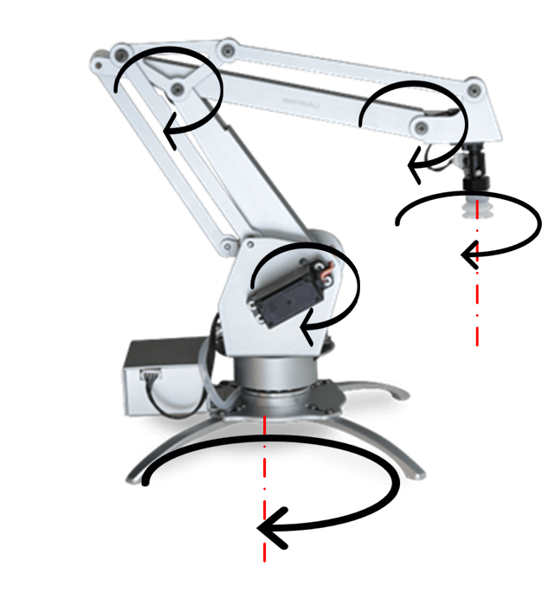
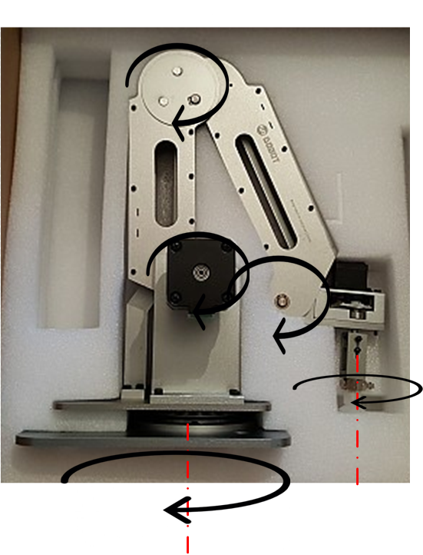
Rotation (joint) Location

Slide 5
Including the Uncontrollable Joint?
Three ways to consider:
Geometry & Full model: Look for a geometric relationship with the other joints and create D&H parameters
Two Stage: Transform desired end-effector pose back to the point at the end of the controllable links (end of third)
Closed form: Determine a closed form solution with trigonometry separate to the toolbox

Slide 6
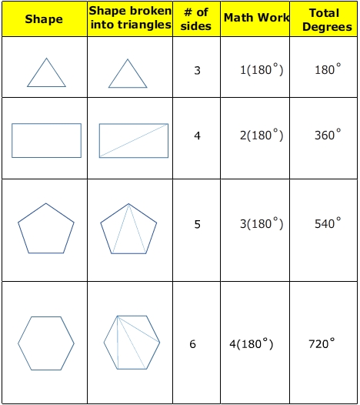
1. Geometry & Full model (1) Angles in Shapes
http://www.softschools.com/

Slide 7
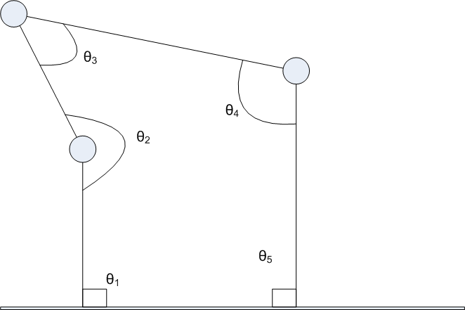
1. Geometry & Full model (2) Compare 5 Sided Shape to Model
http://www.softschools.com/

Slide 8
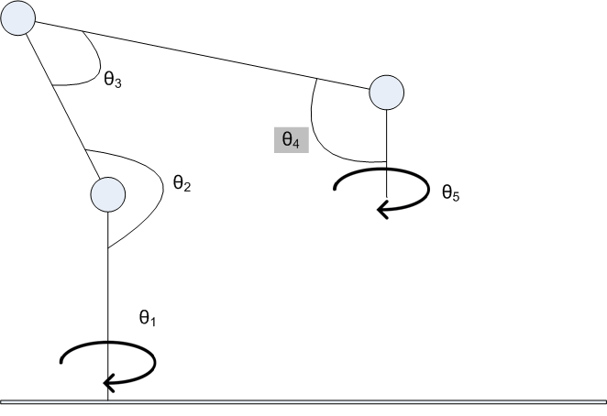
1. Geometry & Full model (3) Model D&H As Usual

Slide 9
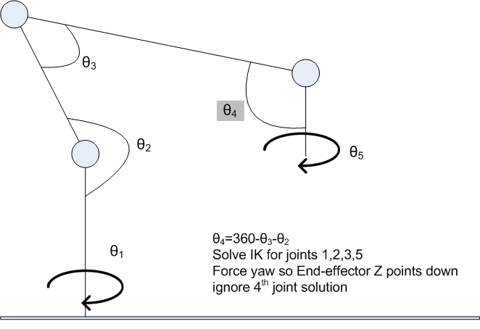
1. Geometry & Full model (4) Solve ikcon within θ₂and θ₃ Limits

Slide 10
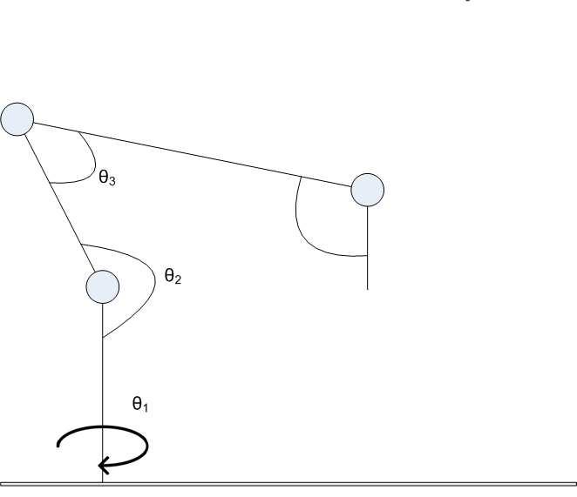
2. Two-stage (1) Create 3DOF D&H Model

Slide 11
2. Two-stage (2) Ignore Motor 4 (only control 3)

Slide 12
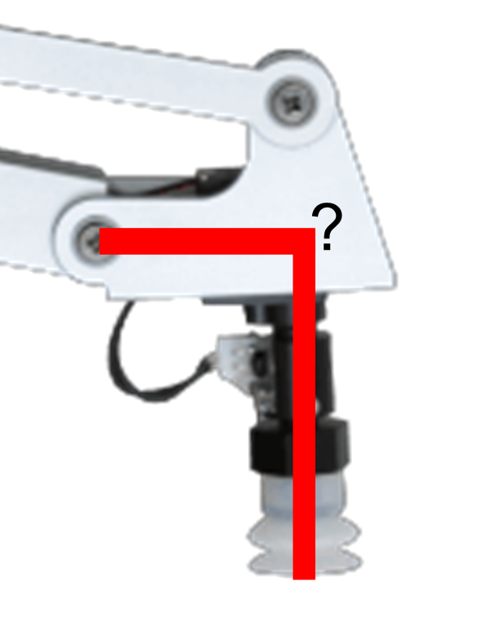
2. Two-stage (3) Determine constant transform End of third link -> End Effector

Slide 13
3. Closed Form (1) Use code provided (uArm only)
Code was originally in Python from project
https://github.com/uArm-Developer/UArmForROS
I translated to Matlab
It needs to be verified
Still need to integrate with Robotics Toolbox in order to plot glyphs

Slide 14
References
“The Sum of the Interior Angles in a Polygon” http://www.softschools.com/math/geometry/topics/the_sum_of_the_interior_angles_in_a_polygon/
uArm For ROS git project https://github.com/uArm-Developer/UArmForROS

